Slide 1

DATA ANALYTICS
To
Optimize Streetworks
{WomenTechWomenYes}
Team member:
Kira
Thomas
Lens
Notes:
optimize street team work effectiveness for fundraising efforts
Get more ppl , attend the gala , contribute to causen

Slide 2
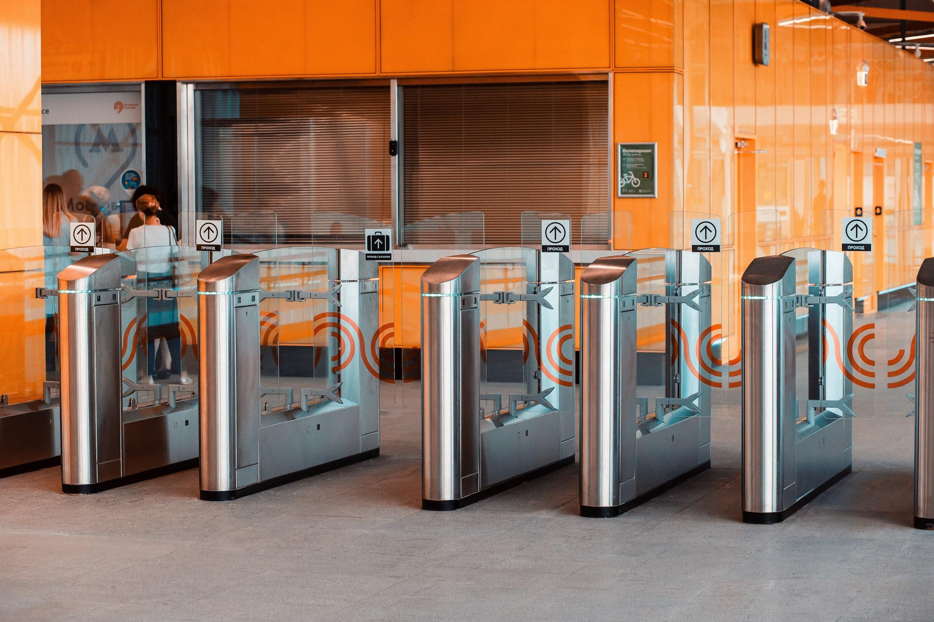

INTRODUCTION
Dataset
Turnstile data
Assumption
More recent dataset used for accuracy (COVID)
More traffic more conversion
Notes:
MTA subway data,

Slide 3

METHODOLOGY
Data Exploration
Excluded odd hours from dataset
Cleaned the dataset
Data Analysis
Grouped entries and exits by date, station name to derive daily traffic

Slide 4
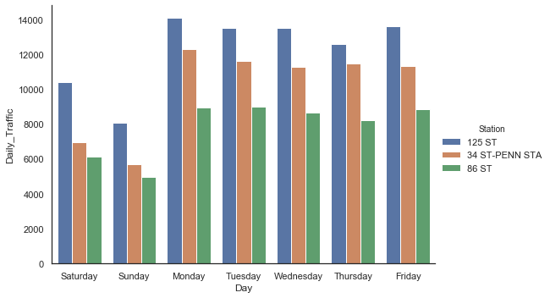
RESULTS

Slide 5
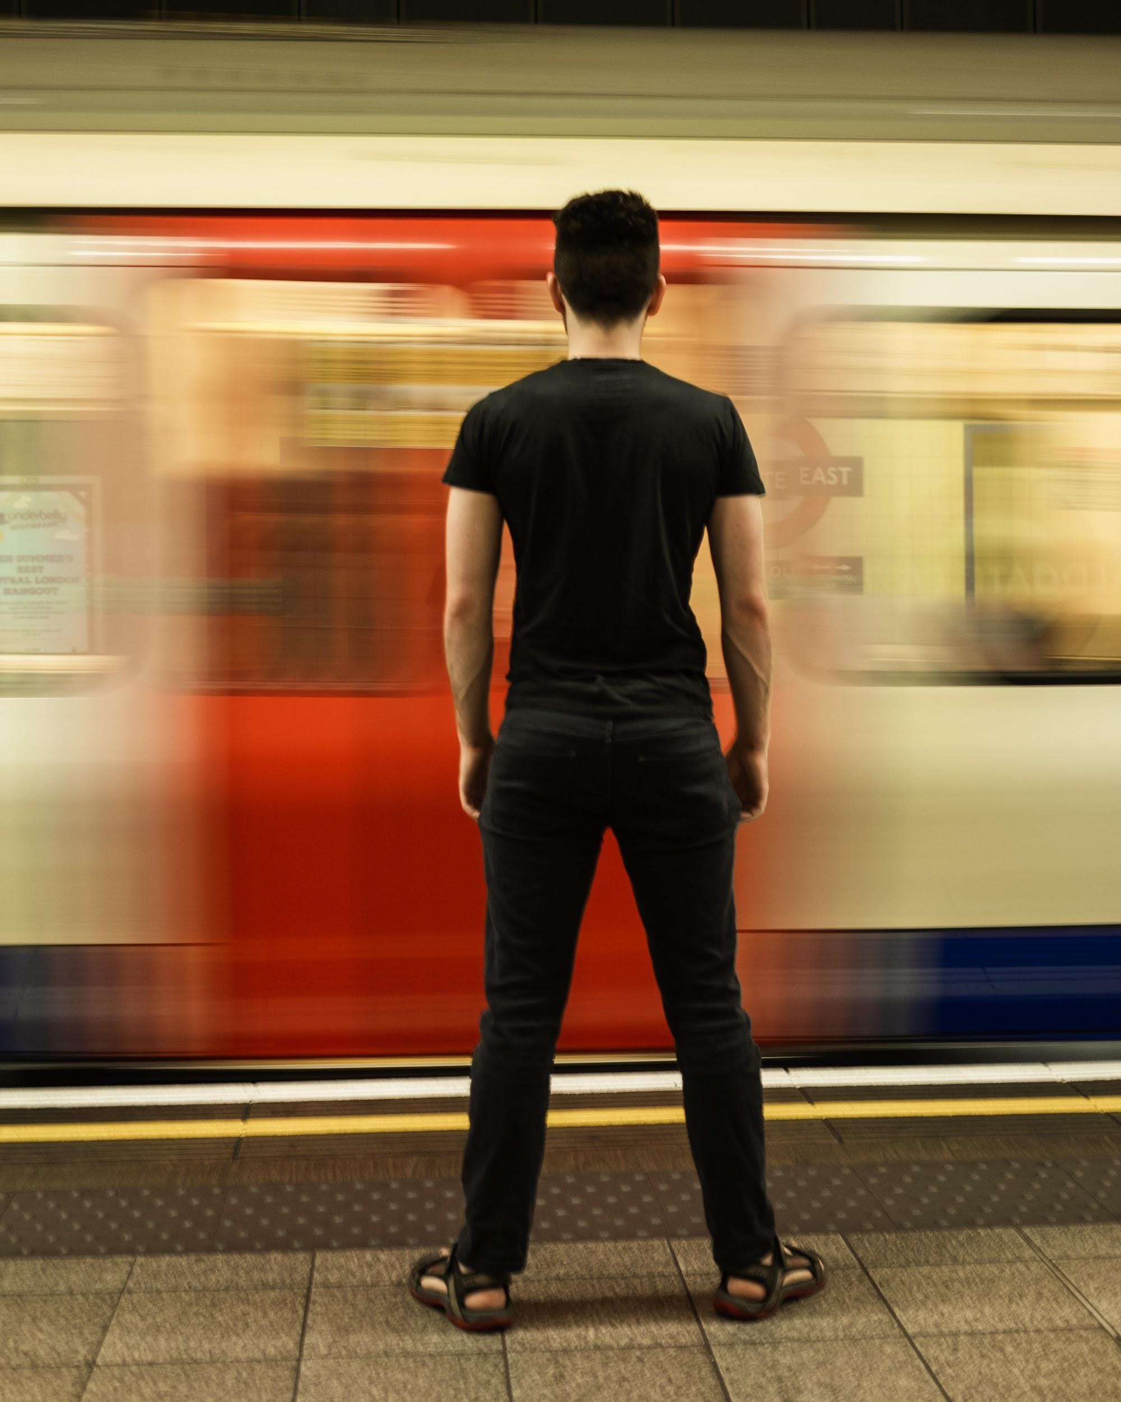
CONCLUSION
125 ST
34 ST-PENN STA
86 ST
Insights
Weekday traffic ↑
Exits > Entries
Notes:
Photo by Matt Winkleft on Unsplash

Slide 6

FUTURE WORK
Location demographics (E.g. technology adoption)
Footfall volume by timing
Number of entrances at Stations
Understanding the issues
Galas in times of pandemics
Notes:
Photo by Drew Beamer on Unsplash

